Slide 1
Cupcake shop
by Adam, Stefan & Nikolai
b. klasse

Slide 2
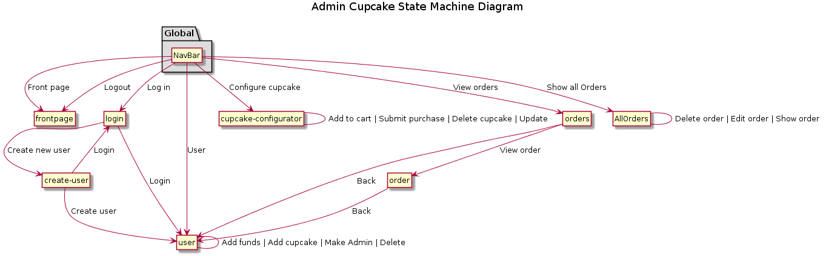
State machine diagram

Slide 3
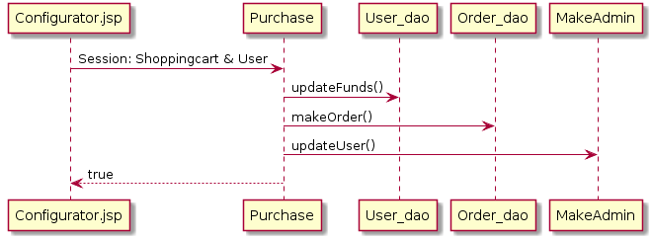
Seq. Diagram – Buy a cupcake

Slide 4
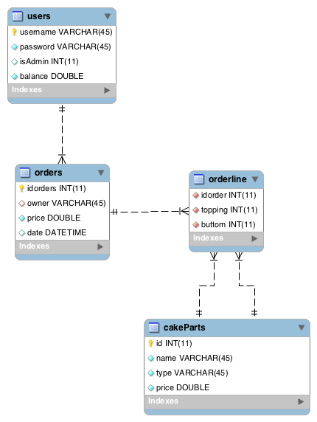
ER Diagram

Slide 5
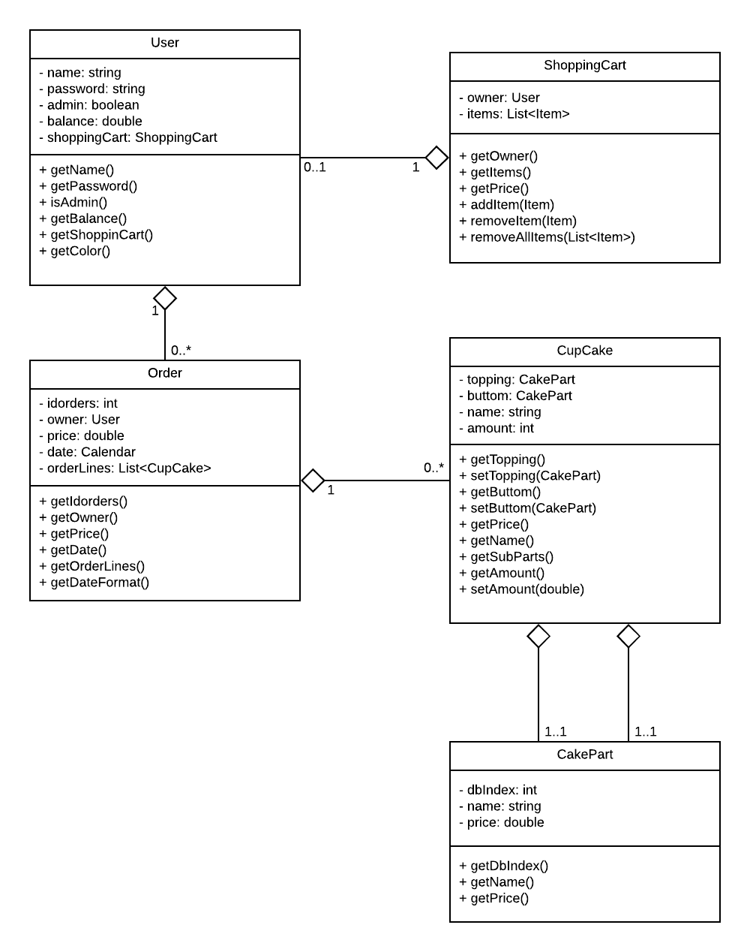
UML diagram

